Slide 1

Search Engine Working

Slide 2
Algorithms
Programs and Formulas to get relevant results
Page Rank
Spelling Check
Synonym check
Auto complete
Query Understanding
Safe Search
User Context

Slide 3
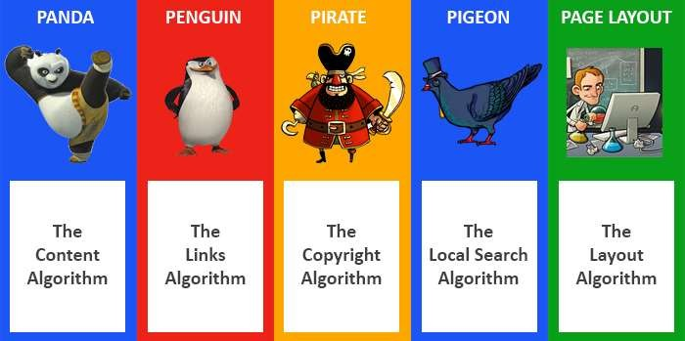
Algorithms

Slide 4
Page Rank Algorithm
Google's first algorithms, which looks at links between pages to determine their relevance.
PR is a number generated for each page available in Google Index
PR Toolbar Range
– NA to 10 (Best Rank) : This is based on Log Scale of 0 – 10
Real Page rank is calculated based on number of pages in index, which can be 0.15 to Trillions

Slide 5
Toolbar Vs. Real PR
Toolbar | Real PR
0 | 0 - 10
1 | 100 - 1,000
2 | 1,000 – 10,000
3 | 10,000 – 100000
4 | 100000 – 1000000
5 | 1000000 - 10000000
http://www.webworkshop.net/pagerank_calculator.php3

Slide 6
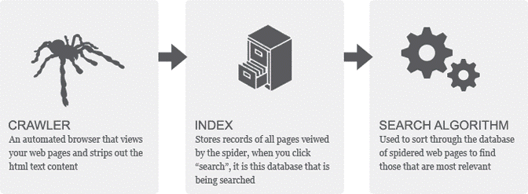
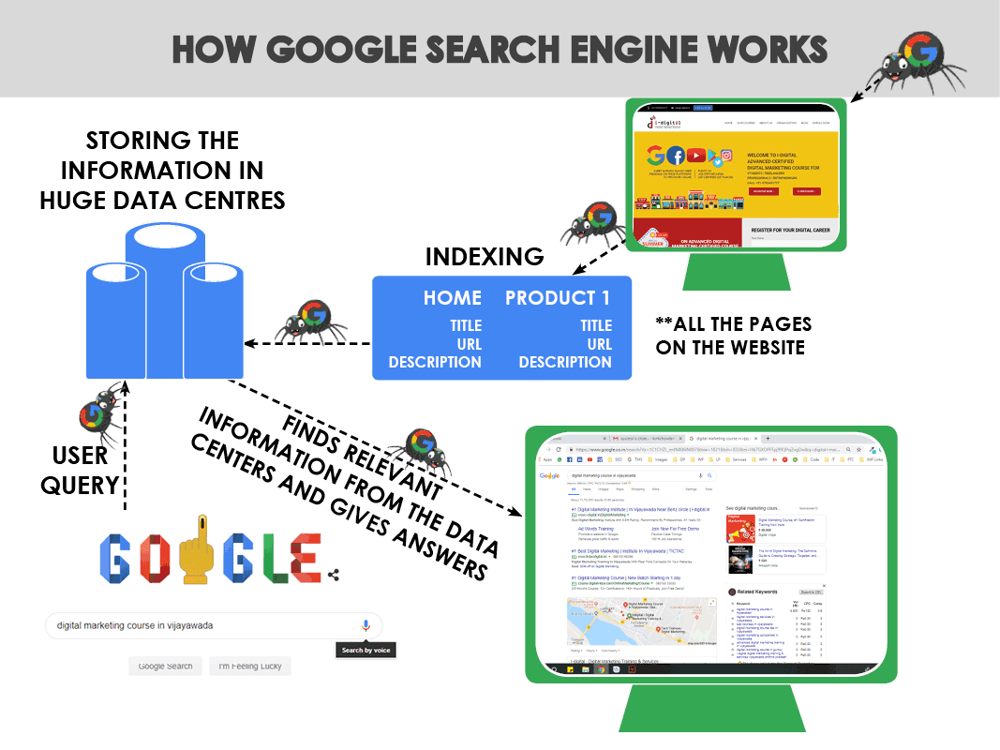
How it Works ?
Google has gone over 654680 experiments with trained external search raters and approved 3234 improvements in 2018.

Slide 7
One Box Answers Queries
When is Independence of India
Time in India or Time in Toronto
1$ to INR
1Mile to Kms
Banana Vs. Apple
Who is wife of Bill Gates
What is my IP
who invented www
Show me pictures of taj mahal

Slide 8
Paid Results
Types of Results
Non Paid Results
Organic Web
PPC Ads
News Results
Image Results
Comparison Ads
Local Results
Video Results
Site Links
Shopping Ads
Schema Data

